Slide 1
Reference books
Manufacturing science by A Ghosh and A K Malik.
Metal casting computer-aided design and analysis by B Ravi.
Principles of metal casting by R W Heine, C R Loper and P C Rosenthal.
Manufacturing engineering and technology by S Kalpakjian and S Schmid
Casting technology and cast alloys by A K Chakrabarti.

Slide 2
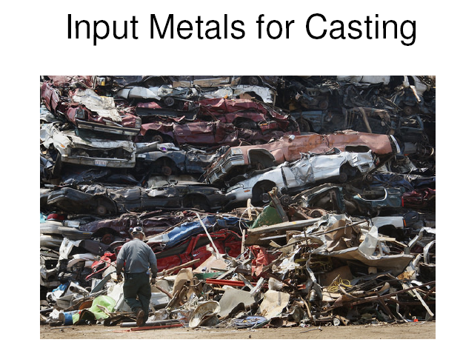
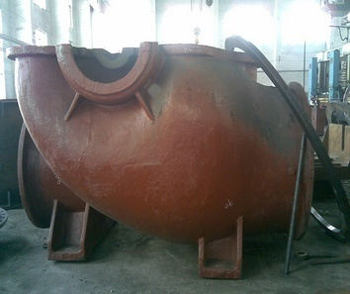
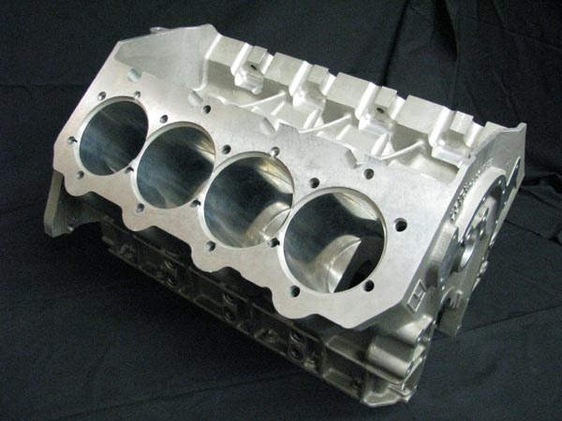

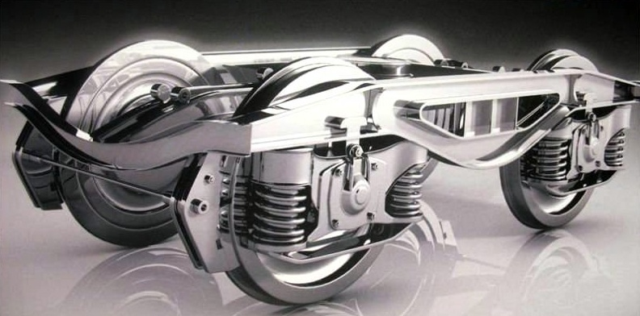
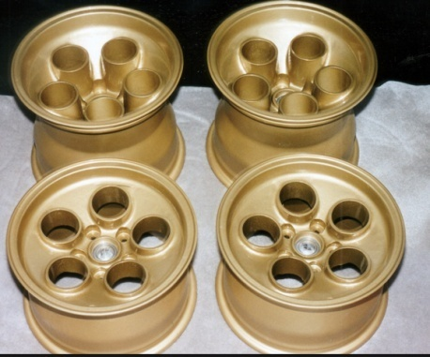
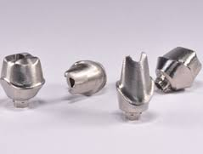

Application of casting- Design and material versatility
Pump housing (Cast iron)
Turbine blade for jet engine
(Ni-alloy)
Engine Block (Al-alloy)
Dental implants (cobalt-chromium alloy)
Rail bogie side frames (Steel)
Wheel of racing cars (Mg-alloy)
Ancient statue (Bronze)

Slide 3
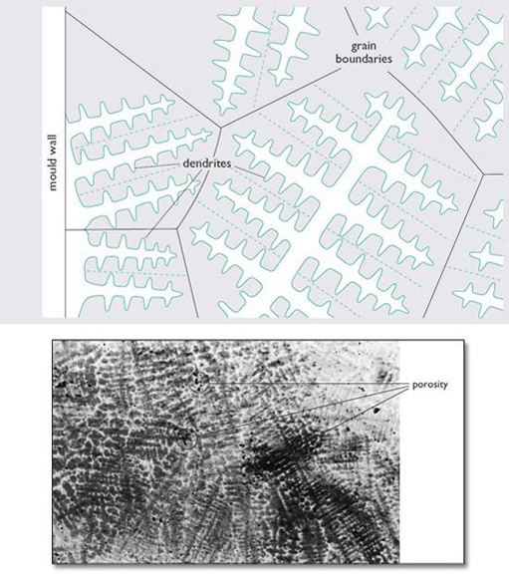

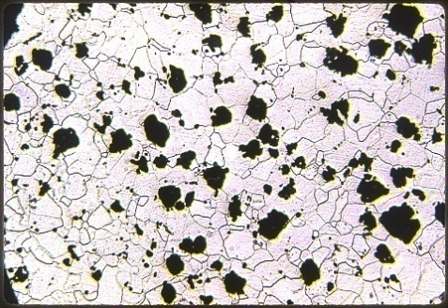
Classifications:
Expendable mould casting: Green sand casting, dry sand casting, cement moulding, CO2 sodium silicate moulding, Investment moulding etc.
Permanent mould casting: Ingot casting, continuous casting, strip casting, die casting, centrifugal casting, squeeze casting, thixo-forming etc.
Microstructure and properties
Depending on selection of materials and processing condition

Slide 4
Sand casting process

Slide 5
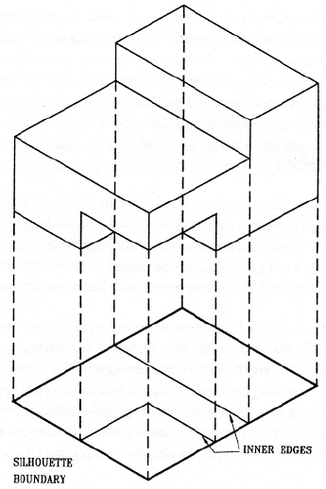
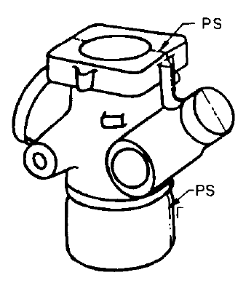
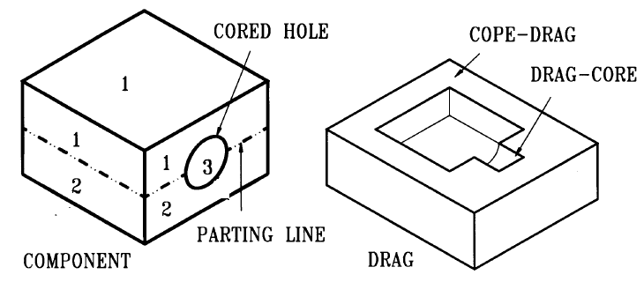
Pattern and core design
Parting line:
Parting line divides the part surface into separate regions each produced by different mould segments.
Parting line coincides with projected boundary of the casting when viewed along the draw direction
The internal angle at the parting line is less than 180 degree.
Flash appears along the parting line.

Slide 6
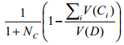
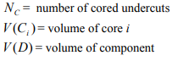
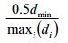
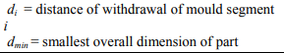
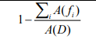
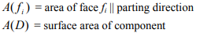
Steps for pattern design:
Select a feasible parting/draw direction and decide the parting line using its projected boundary when viewed in draw direction
A flat parting plane is preferred to avoid side thrust, complexity in tooling and mould making.
Evaluate the undercuts, and the number of core and volume of core for the above parting line and draw direction. Select parting direction such that undercuts should be absent or minimized.
The draw distance should be minimum with flat parting plane
The draft area should be minimum
Where
Where
Where

Slide 7
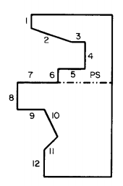
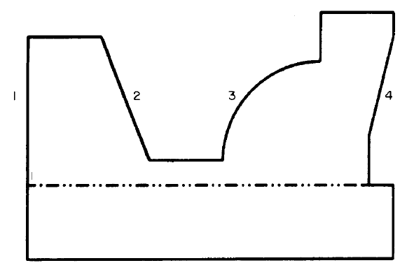
Pattern allowances considering the position of the critical surface and sharp corners/abrupt change in thickness,

Slide 8
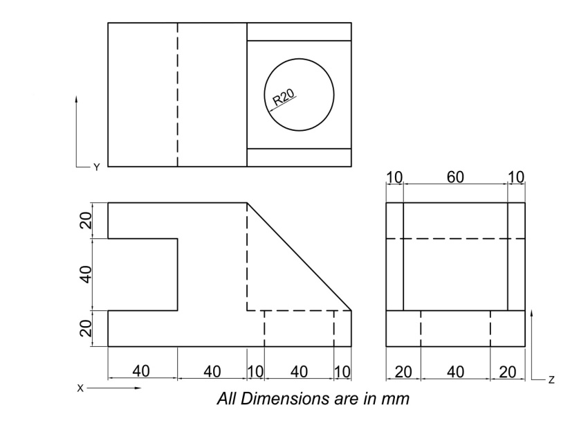
Q. For the bracket casting shown below, compare the three draw directions X, Y and Z (with parting line at X=80 mm, Y=40 mm and Z=20 mm) in terms of draw distance and undercut volume (with number of core). Show the core and pattern with parting line.

Slide 9
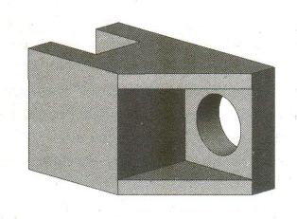
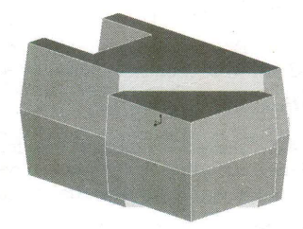
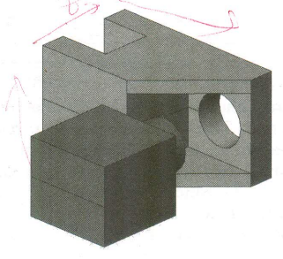
Pattern
Component
Core

Slide 10
Shrinkage or contraction allowance
Liquidus temp
Tp
L
Solidus temp
Temp
Tl
Freezing range
L+S
Ts
Time
S
Ta
solidification shrinkage
Alloy composition
liquid shrinkage
Vol
solid shrinkage
Liquid and solidification shrinkage is taken care of by riser in the feeder design.
However solid shrinkage is taken care of by the shrinkage allowance by providing excess dimensions to the pattern.
Ts
Tl
Temp

Slide 11
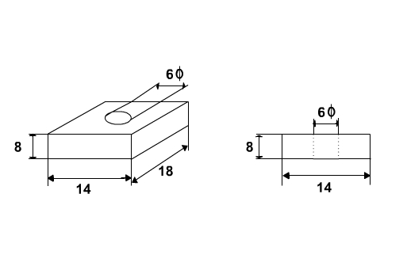
Q. The casting shown is to be made in cast iron using a wooden pattern. Assuming only shrinkage allowance, calculate the dimension of the pattern. All Dimensions are in Inches
Material | Dimension | Shrinkage allowance (inch/ft)
Grey Cast Iron | Up to 2 feet 2 feet to 4 feet over 4 feet | 0.125 0.105 0.083
Cast Steel | Up to 2 feet 2 feet to 6 feet over 6 feet | 0.251 0.191 0.155
Aluminum | Up to 4 feet 4 feet to 6 feet over 6 feet | 0.155 0.143 0.125
Magnesium | Up to 4 feet Over 4 feet | 0.173 0.155

Slide 12
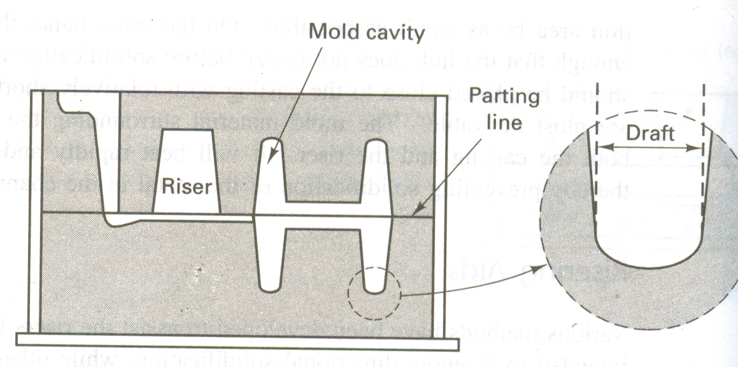
Draft allowance
Height of pattern (mm) | Metallic pattern (machine moulding) | Wooden pattern (manual moulding)
Upto 20 | 1⁰ 30’ | 3⁰
20-50 | 1⁰ | 1⁰ 30’
50-100 | 0⁰ 45’ | 1⁰ 15’
100-200 | 0⁰ 30’ | 0⁰ 45’
200-300 | 0⁰ 30’ | 0⁰ 30’
300-800 | 0⁰ 20’ | 0⁰ 30’
800-2000 | - | 0⁰ 30’
More than 2000 | - | 0⁰ 30’
Size
Material
Method of removal
Draft is the taper provided by the pattern maker on all vertical surfaces of the pattern so that it can be removed from the sand without tearing away the sides of the sand mold.

Slide 13
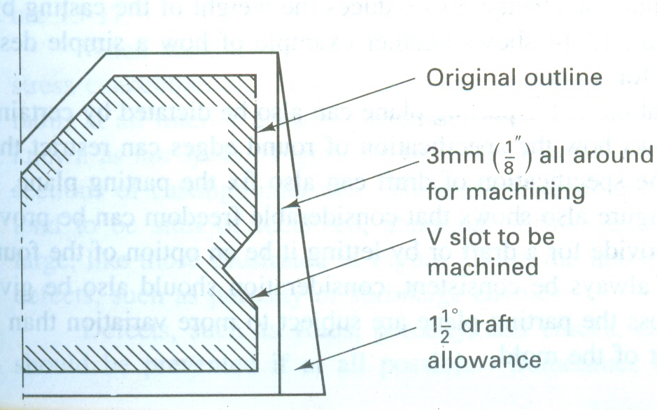
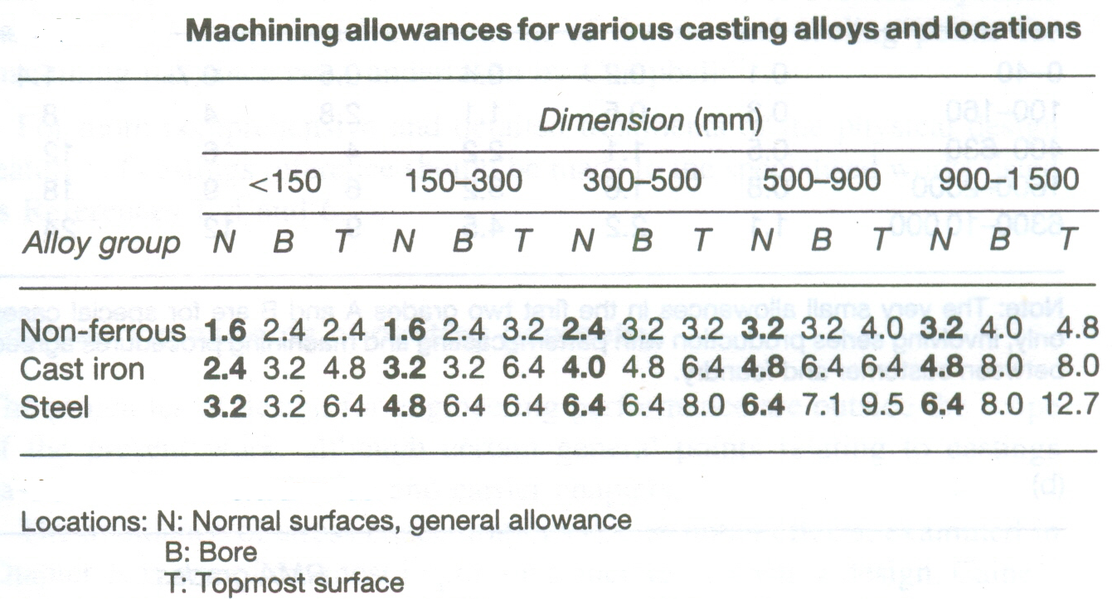
Machining allowance
Material
Dimension
Surface
Machining allowance for thickness of metallic layer to be removed from the casting to get desired surface finish, dimensional accuracy and intricate shape.

Slide 14
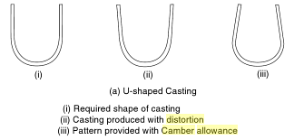
Distortion or camber allowance
Types of metal
Shape
Thickness
The distortion in casting may occur due to internal stresses. These internal stresses are caused on account of unequal cooling of different section of the casting.

Slide 15
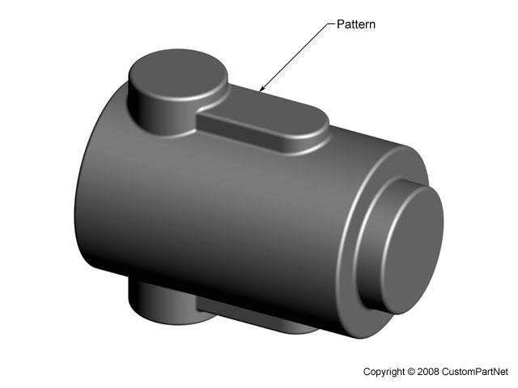
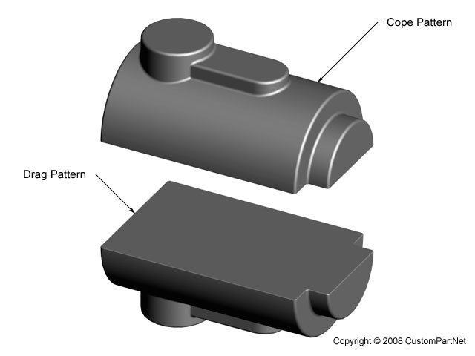
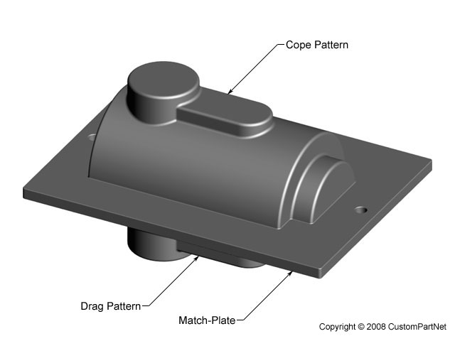
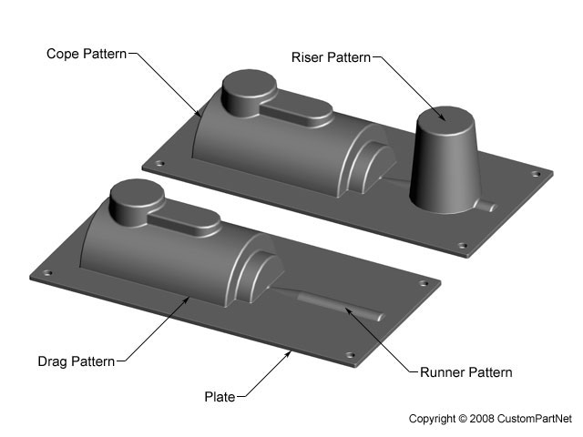
pattern
cope pattern
drag pattern
Type of pattern
Solid pattern
Split pattern
cope pattern
cope pattern
riser
drag pattern
match plate
drag pattern
runner
Match plate pattern
Cope and drag pattern

Slide 16
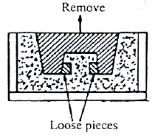
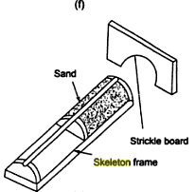
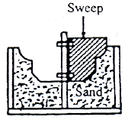
Loose piece pattern
Skeleton pattern
sweep pattern

Slide 17
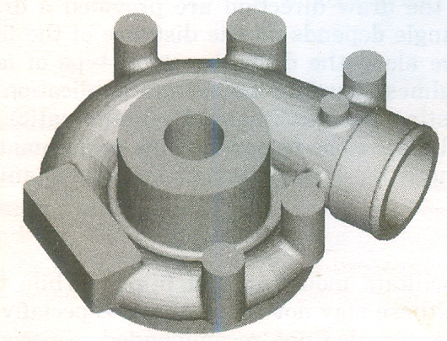
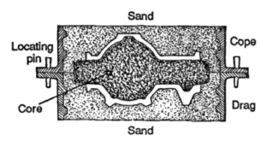
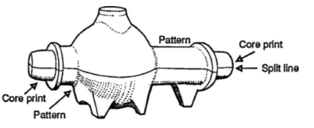
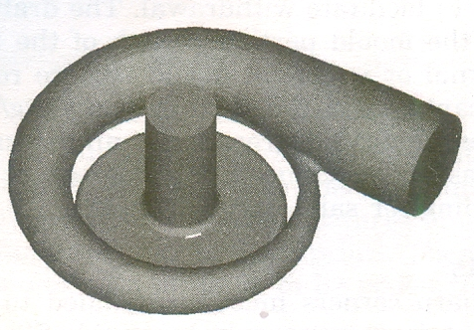
Core: (fabricate holes, internal cavities, undercuts)
Compressor casing
Core consists of body and core prints
Core

Slide 18
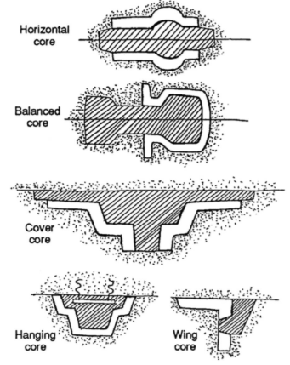
Core should have high hot strength, refractoriness, permeability, and collapsible.

Slide 19
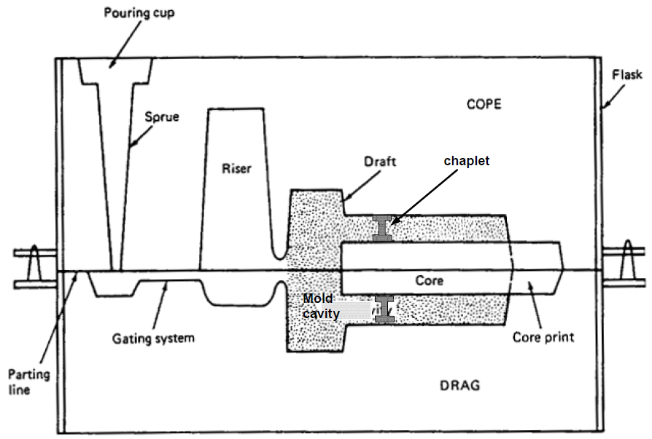
The core print design:
The print must balance the body weight so that core does not fall during mold assembly
The print must not crush the mold with the bouncy force of the metal.
The print should allow the internal gas to escape from the mold.
The print should not hinder the heat transfer from the core to the mould.
The print should minimize the shift and deflection of the core with use of chaplets if necessary
Q. Brass chaplets are used to support sand core inside a sand mold cavity. The projected core print area is 13 cm² for each end of the cylindrical sand core which support at both ends. The design of the chaplets and the manner in which they are placed in the mold cavity surface allows each caplet to sustain a force of 45 N. If the volume of the core = 7.5X10³ cm3, and the metal poured is brass, determine the minimum number of caplets that should be placed (a) beneath the core, and (b) above the core. (Density of sand core and brass are 1.6 and 8.67 gm/cm3 respectively, and the green sand strength is 6.9X10³ N/m²
N/m²)

Slide 20
AFS grain fineness number
Take 50 gm of dried sand on the topmost sieve. The whole assembly is placed on the sieve shaker and is agitate for 15 minutes.
Weigh the amount of sand remaining on each sieve and record in terms of % of original 50gm sample.
Multiply the results for each sieve by a multiplying factor.
The multiplication products are summed and then divided by sum of grain % obtained.
6
12
20
30
40
50
70
100
140
200
270
PAN

Slide 21
Sieve No | Aperture(mm) | Multiplier (A) | Weight retained (gm) | Weight retained in % (B) | C=A×B
6 | 3.327 | 3 | - | - | 0
12 | 1.651 | 5 | - | - | 0
20 | 0.833 | 10 | - | - | 0
30 | 0.589 | 20 | 2.0 | 4.0 | 80
40 | 0.414 | 30 | 4.7 | 9.4 | 282
50 | 0.295 | 40 | 7.3 | 14.6 | 584
70 | 0.208 | 50 | 14.8 | 29.6 | 1480
100 | 0.147 | 70 | 16.2 | 32.4 | 2268
140 | 0.104 | 100 | 3.4 | 6.8 | 680
200 | 0.074 | 140 | 1.1 | 2.2 | 308
270 | 0.053 | 200 | 0.2 | 0.4 | 80
Pan | - | 300 | 0.1 | 0.2 | 54
Total | - | - | 49.8 | 99.6 | 5814
AFS Grain Fineness number=(∑C)/(∑B)= 5814/99.6=58.3≈58

Slide 22
This AFS#GFN-58 is a 3 screen sand which can be used for hotter metal and larger casting.

Slide 23
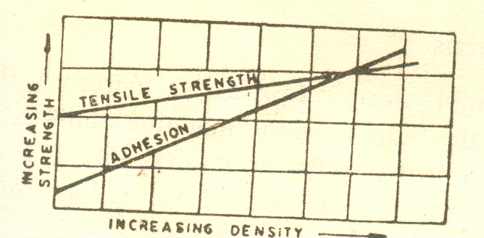
Lifting properties of pattern: Sand sticking to pattern while lifting from the mold are caused by inadequate draft, faulty draw mechanism, improper ramming and poor sand mixes which changes number of adhesive bonds.
weight
pattern
sand
Clay content

Slide 24
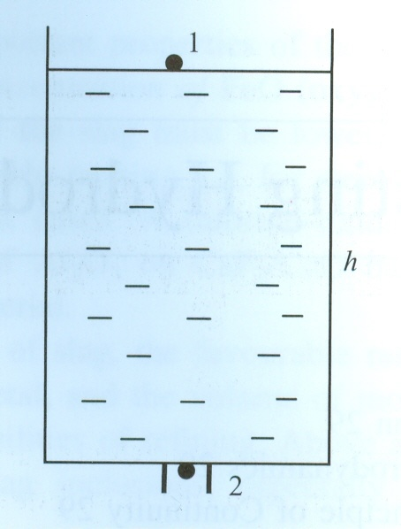
Teeming of metal melt out of ladle
h2=0, h1=h, p1=p2=p=atm pr
V1 is neglected compared to V2

Slide 25
Q. A ladle with a circular cross-section (diameter 2.0 m) contains 70X10³ kg molten steel. The steel is teemed through a circular hole in the bottom of ladle. The diameter of the hole is 3.0 cm. Calculate the time required to empty the ladle.
Density of steel is 7.8X10³ kg/m³
Soln:
V1 can be neglected compared to V2 in Bernoulli’s equation

Slide 26
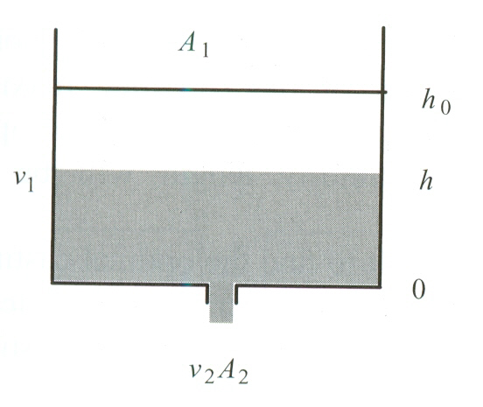
h=0
Ans=3391 sec=56.5 min

Slide 27
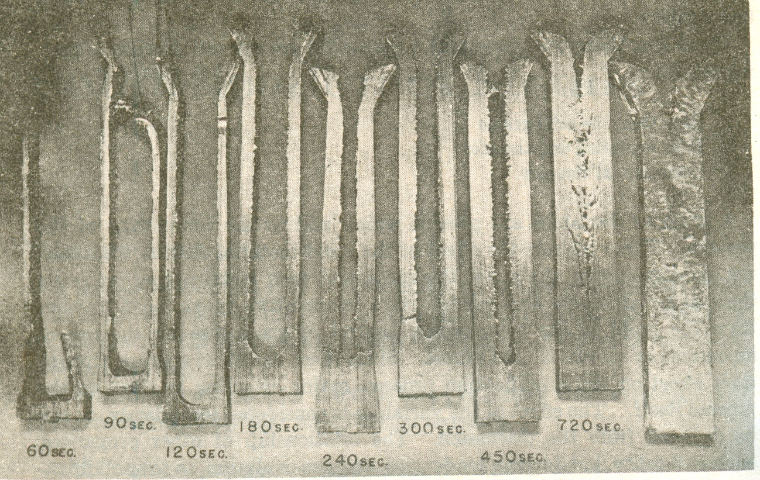
Solidification in casting
D=k(t)^{1/2}-c
k,c=constants, where k depends on size of casting and rate heat extracted from mould, and c depends on degree of super heat
t= time

Slide 28
Solidification mechanism
Assuming H and S values are constant for both solid and liquid
ΔGv
ΔT
T_{E}
At melting point Tm, Gs=Gl, → Hs-T.Ss=Hl-T.Sl Hs-Hl=T. (Ss-Sl)=-(Latent heat of solidification)
ΔG_{V} drives nucleation and growth of solid phase

Slide 29
Thermodynamics to solidification
For any temperature T, for freezing to occur
Material must be supercooled to below TE
2. Latent heat of solidification must be dissipated

Slide 30
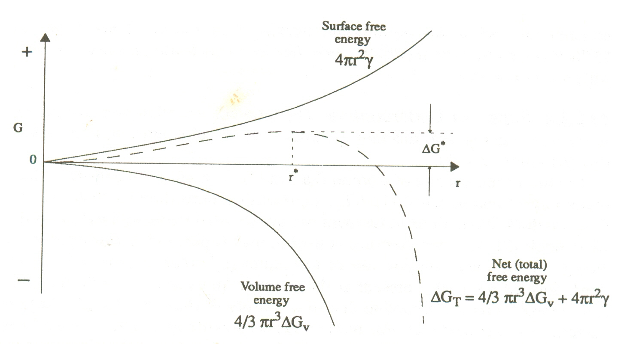
Nucleation of crystalline solid

Slide 31
There is a critical size of new phase (embryo) to become stable and grow. Hence there exists an energy barrier to solidification.

Slide 32
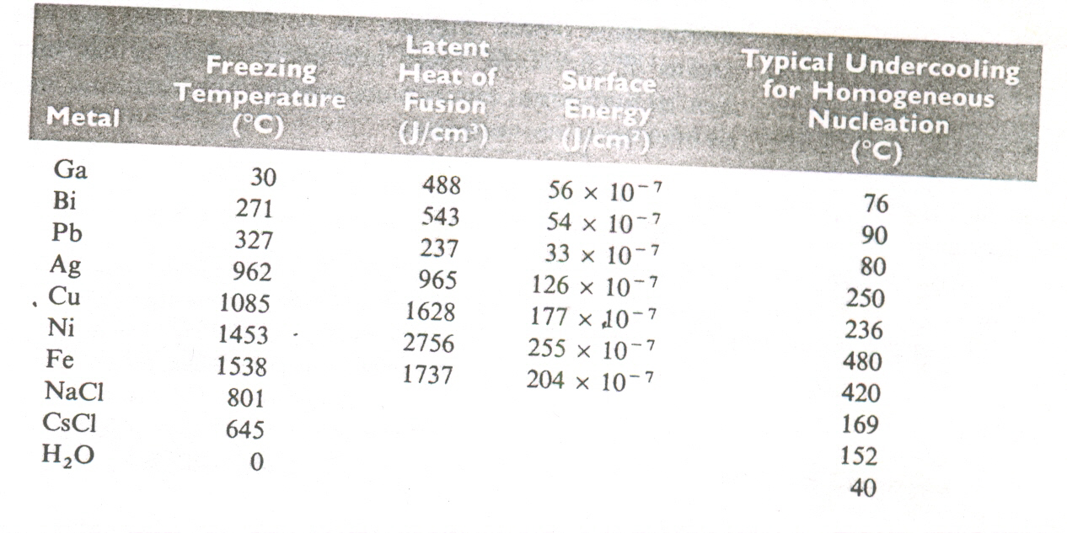
Q. Suppose that liquid copper is undercooled until homogeneous nucleation occurs. Calculate (a) the critical radius of nucleus required and (b) the number of copper atoms in the nucleus. Assume that the lattice parameter of the solid FCC copper is 0.3615nm, freezing temperature is 1085⁰C, latent heat of solidification is 1628 J/cm³, surface energy J/cm² and typical undercooling for homogeneous nucleation is 236⁰C

Slide 33
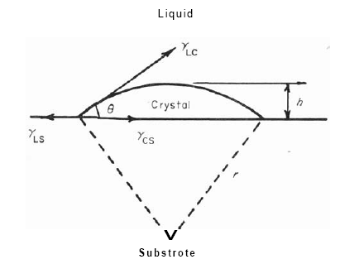
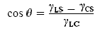
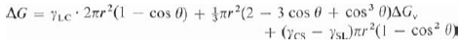


Nucleation due to nucleating agents
3

Slide 34


Segregation during solidification
Cs
Cl

Slide 35

Composition of solid at the advancing solid-liquid interface

Slide 36
Scheil equation

Slide 37


Nucleation and growth
Fine equi-axed grains near the under-cooled mould wall due to high rate of nucleation
Latent heat of fusion is released and remaining liquid metal rapidly loses under cooling
Growth continues from the nucleated grains opposite to the direction of heat flow (due to temperature gradient).

Slide 38

Possible casting microstructure

Slide 39


Dendritic structure

Slide 40


Slide 41


Mold center line
AB= time interval between start and end of freezing at center line of mold
OB= total solidification time
Distance from mold interface
A
B
Time (min)
Center line feeding resistance (CFR)=(100*AB)/(OB) %
If CFR>70% then feeding is considered to be difficult

Slide 42
Q. 0.6 % carbon steel has following data for sand and chilled mold casting. Which will be difficult to feed?
Start and end of freezing time at the centre line= 24, 48 min (for sand mold) & 8, 10 min (for chill mold).
Assume liquid metal starts freezing at the mold wall as soon as it is filled.

Slide 43

Heat transfer and solidification time for an insulating mold
α_{M}=K/(ρ.C) for mold material=thermal diffusivity for mold

Slide 44


Slide 45

Error function

Slide 46

Super heat
Heat balance,
Latent heat
Chvorinov’s Rule

Slide 47
Q. A metal with melting temperature of 700⁰ C is poured into the sand mold that is initially at 30⁰ C.
How thick must a mold be to be considered semi-infinite for times of 1 min and 15 min after pouring the metal?
(Properties of sand mold given are: specific heat=1.16 J/g.⁰C, thermal conductivity=0.6 W/m.⁰C and density=1.5 g/cm³).

Slide 48


Slide 49
Q. Your company currently is producing a disk-shaped brass casting 2 in. thick and 18 in. in diameter. You believe that by making the casting solidify 25% faster, the improvement in the tensile properties of the casting will permit the casting to be made lighter in weight. Design the casting (maintaining the same diameter) using the same casting process to permit this. Assume that the mould constant is 22 min/in2 for this process.
Q. Using Chorinov’s rule determine the solidification times of sand casting of Al, Cu and Fe poured into the molds with mold cavity dimensions of 10cmX10cmX10cm and then of 20cmX20cmX2.5cm, with superheats of 10, 100 and 200 ⁰ C

Slide 50


Slide 51

metallic mold with air gap

Slide 52







Slide 53

Riser
It helps to know the complete mould filling
Provided for compensating the liquid and solidification shrinkage during casting by feeding extra liquid metal (also feeder)
Venting of entrapped gases from mould
It provides extra metal pressure on the casting to reproduce mold details
Types: side riser, top riser, hot (live) riser, cold riser, open riser and closed riser

Slide 54


Design consideration (The seven feeding rules)
Rule-1: Do not provide feeder unless necessary as the casting yield will decrease.
Casting Yield in %=100*(wt. of the casting shipped/wt. of the liquid metal poured)

Slide 55
Rule-2: Feeder/Riser must not also solidify completely before the casting solidifies i.e time of solidification of riser (tr) should be higher than that of casting (tc).
Chorinov’s rule
riser
casting
t= solidification time, K=mold constant and V/A=Modulus
For successful riser design, tr>tc
i.e.
>

Slide 56




There are two cases
Kr=Kc
Mr=1.1-1.2Mc
Kr
Kc

Slide 57

2. Kr>Kc and Mr<Mc, still the inequality tr>tc holds good
Kr
Kc
Insulating riser sleeve

Slide 58

Caine’s method
a=0.1
b=0.03
c=1.0

Slide 59

Rule-3: Feeder must contain sufficient liquid metal to feed the contraction requirement of both itself and casting.
Where e is feeder efficiency=14%
is contraction coefficient=7 % for Al and 4% for steel

Slide 60

Rule-4: There must be a path to reach the feed metal to the required region (hot spot). This can be achieved if there will be directional solidification of the casting as whole towards the riser.

Slide 61


Rule-5: Junction requirement (side riser)
Add extension to the section by effectively moving the junction of the casting
Avoid the hot spot from the middle of the junction by Mr>2Mc
Provide spherical shape at the base to save metal in riser.

Slide 62



Rule-6:Pressure requirement
Casting with blind feeder should be correctly vented out using William’s core
Liquid level (pressure head) in the feeder to be sufficient to drive feeding to top section in the casting

Slide 63




Rule-7: Temperature gradient
Riser size with Mr=1.1Mc

Slide 64

Q. Design a cylindrical riser with a height equal to twice its diameter that will compensate for shrinkage in a 2 cmX8 cmX16 cm casting. Note that (i) the riser should take 25 % larger time to solidify than casting (ii) the feeder efficiency is 15% and the shrinkage coefficient is 2%.
Q. Shows cylindrical riser attached to a casting. Compare the solidification times for each casting section and the riser and determine whether the riser will be effective.

Slide 65


Q. Shows a cylindrical riser attached to a casting. Compare the solidification times for each casting section and the riser and determine whether the riser will be effective
Q. Design an efficient risering system for casting shown in figure. Be sure to include a sketch of the system along with appropriate dimensions. Note that (i) the riser should take 25 % larger time to solidify than casting (ii) the feeder efficiency is 15% and the shrinkage coefficient is 2%.

Slide 66

Gating system
The elements of the basic common gating system are the pouring basin, downsprue, sprue well, the runner, and ingates.
Depending on the orientation and position, the gating systems are classified as: 1.Horzontal or vertical gating systems
2. Top, bottom or middle gating system
Attributes for ideal gating system
The gating system should be capable of preventing refractory particles, oxides and sand particles (from the mold) from reaching the mold cavity. Use of pouring cup, dam, relief sprue, skim bob, strainer, splash core, runner extension etc in the gating system.

Slide 67







parting gates

Slide 68

Avoid the entrainment of air or gases in the metal stream.

Slide 69

Mold filling time
The gating system should be designed such that it may be necessary to fill the mold before the freezing of the thinnest section.
Top gating
Ag
R.A. Flinn, Fundamentals of metal casting

Slide 70

At 1 and 4 the pressure is atmospheric
Velocity at 1 is zero (maintained at constant height) and velocity at 4 is negligible compared to V3 (Vg)
dh
Bottom gating

Slide 71
At t=0, h=0 and t=tf, h=hm
Empirical relation (pouring time)
Gray cast iron<1000 lb
Gray cast iron>1000 lb
Steel casting

Slide 72


Class assignment- Two gating designs for a mold of 50cmX25cmX15cm are shown in figure. The cross sectional area of the gate is 5 sq.cm. Determine the filling time for both the designs.
Ans=21.86 sec and 43.71 sec

Slide 73

Assignment
You work in a cast house of a steel company where you intend to start uphill casting of steel. The head of production ask you how long will it take to fill six moulds that are connected to a central gating system (one of them is shown in the figure below). Calculate the filling time.

Slide 74


Steps for gating design:
To limit the velocity of melt at the ingate within a critical limit i.e. 1.0 m/sec for ferrous metal and 0.5 m/sec for aluminium alloy to achieve smooth flow in the mold. (i.e. 50-mm and 13-mm fall for ferrous and aluminium alloy)
Slow rising speed in bottom gate filling against the melt head in the mold and hence reduce erosion and splash.
Ingate should never be placed directly opposite to core (avoid core erosion)
Multiple ingates (with reduced diameter of the ingate) to distribute melt so that the distance of flow from any ingate from the farthest point filled by that ingate is less than fluidity distance.

Slide 75


5. Introduce molten metal into the mold cavity at locations such that directional solidification promoted.
6. Ingate must be easy to fettle i.e. it should have smaller cross section and preferably the ingate junction should a flat surface with a thick section of the casting.
When several ingates are present, one that is most likely to cause damage determines the criteria assessment value defined as,
The best position is thick section which allow molten metal to flow to other sections with minimal cooling.

Slide 76



7. It should be commercially practicable with maximum casting yield.
Where, Nc is number of casting cavities per mould, vc is the volume of each cavity, and vg is the volume of the common gating system for all the cavities in the mold.
Issue with multiple ingate system (parallel finger ingates)

Slide 77







Slide 78

Fluidity
Fluidity is the ability of liquid metal to flow and fill the mold. (runability)

Slide 79
Factors influencing fluidity
Characteristics of alloy solidification
Viscosity of liquid metal
Heat content of metal
Mold properties and Pouring condition

Slide 80

Characteristics of alloy solidification

Slide 82


Slide 83

Heat content
Fluidity of magnesium is 2 times lower than that of aluminium

Slide 84

Viscosity

Slide 85
Mold properties and pouring condition
Theromophysical property i.e. conductivity of the mould and temperature of the mould
Gas permeability of the mould and state of the mould surface
Height of sprue

Slide 86

Constitutional under cooling

Slide 87


Slide 88

Casting defects
1. Inclusions
Sand, slag, dross, oxides or other materials embedded in casting
Quality control during melting by degassing, design of gating system to minimize turbulence, erosion of mold wall and aspiration, and adoption of filtration technique.

Slide 89

2. Hot tears
Tearing of casting at the grain boundaries in the later part of the solidification.
Change of geometry of casting, mold material, alloy composition.

Slide 90



Laboratory experiment

Slide 91



Slide 92





3. Blow holes and pin holes (gas porosity)
Caused by entrapped gases like CO, H or steam etc.

Slide 93
Proper melting practice with degassing, reducing moisture content in the mold, proper gating system to avoid aspiration, high permeable mold and core, and avoid use of rusty chaplets and chills.

Slide 94


4. Macro and micro porosity due to shrinkage
If liquid and solidification shrinkage is not compensated by riser
Proper riser design and placement which drive directional solidification. Chemistry of the liquid metal. Use of chill mold.

Slide 95






Slide 96

5. Misrun and cold shut
Inefficient fluidity of molten metal
Proper chemistry of the metal with superheat. Design of gating system. Good permeability of mold.

Slide 97



6. Scab and rat tail
High clay content having deformation capacity at high temperature. Additives to counter expansion include wood flour, coal dust and cereal binders

Slide 98

7. Metal penetration and sand burn
Less grain size, sand strength should be sufficient to withstand metalostatic pressure, high refractoriness of sand.

Slide 99

8. Mismatch
Misalignment of pattern and improper handling of mold.

Slide 100


g
A1.V1=A2.V2
Where A1 and A2 are the cross sectional areas at points 1 and 2 and V1 and V2 are the fluid velocities at point 1 and 2.

